Slide 1
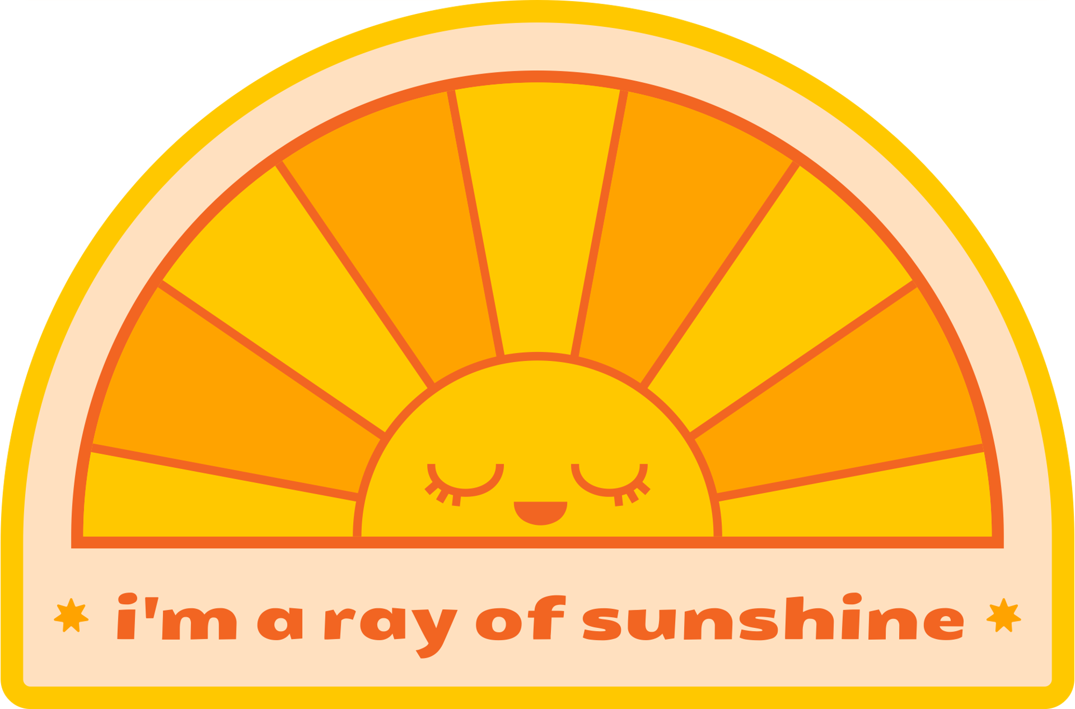
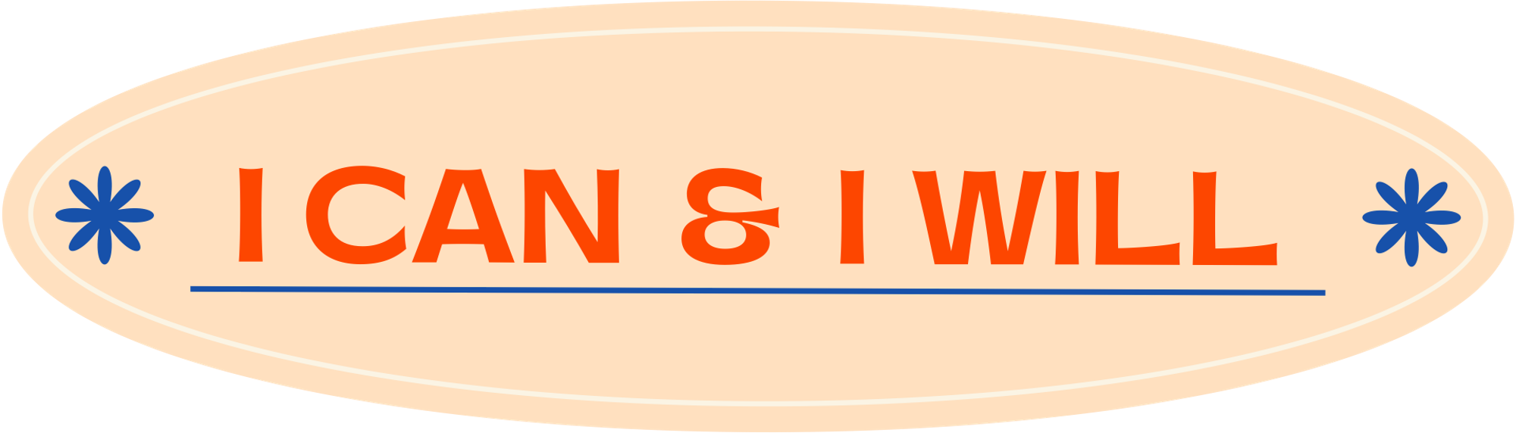


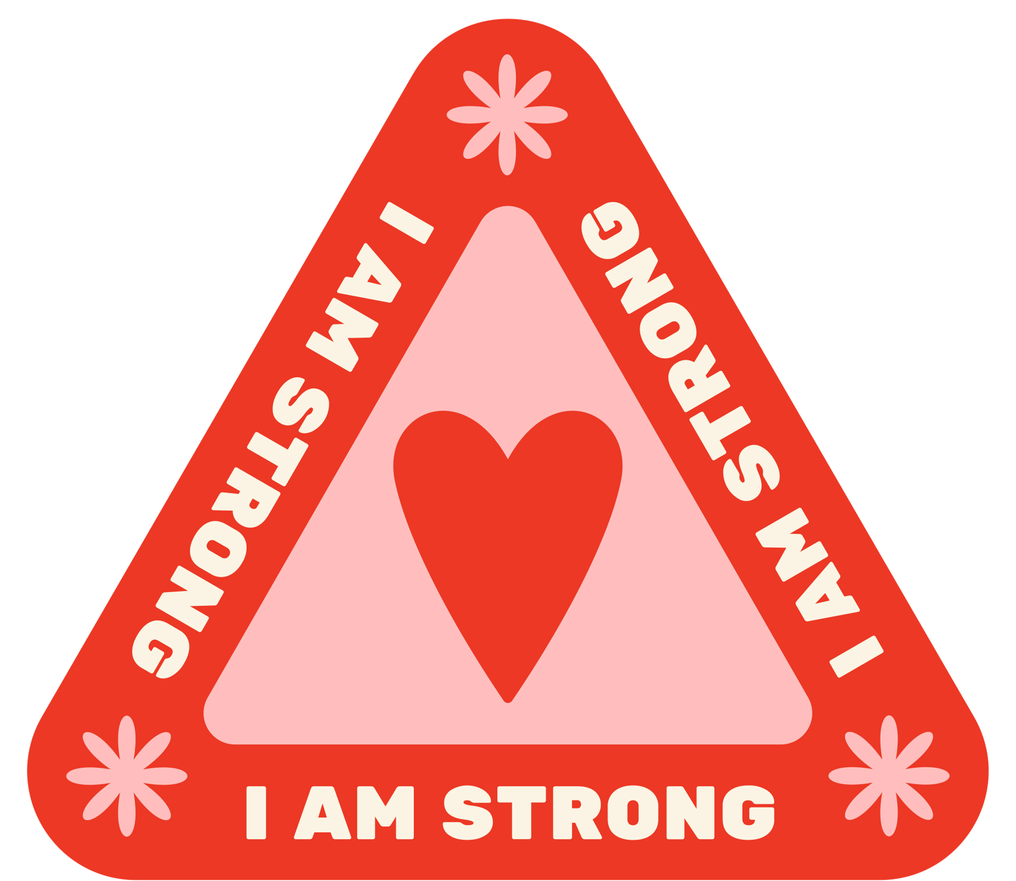



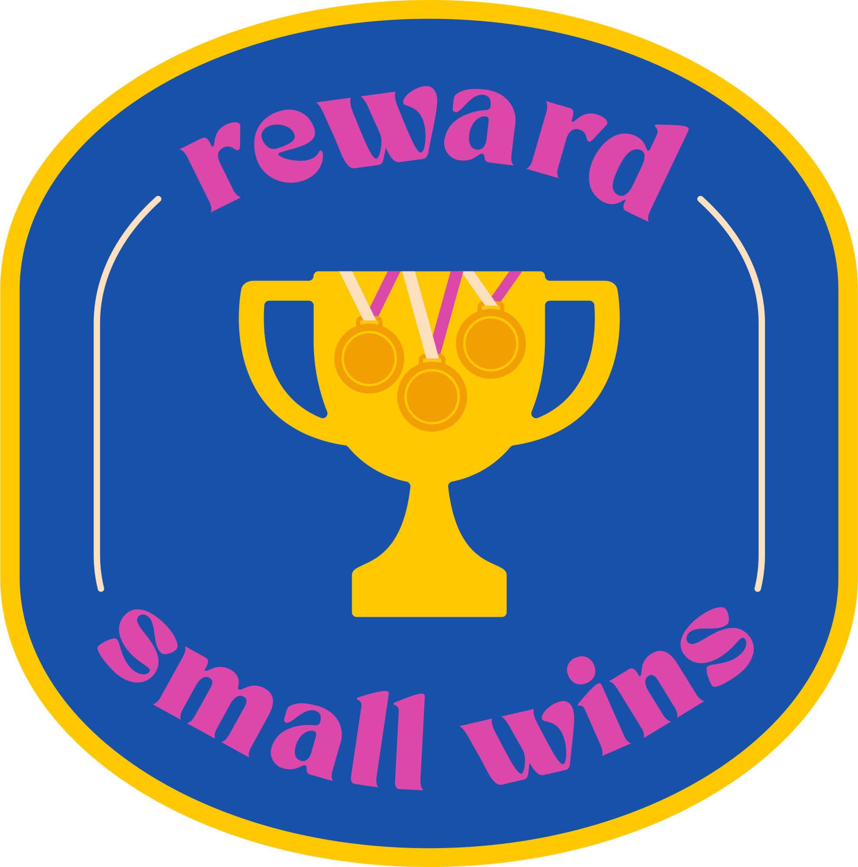

Life-Situation Interventions:
INTRAPERSONAL WELLNESS, EMOTIONS, AND LIFE EVENTS
Week 11
Notes:
Designed and created by Dandi Yang. Do not duplicate or upload with the express written permission of the author.

Slide 2
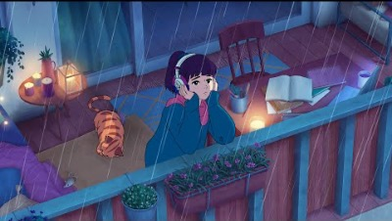
Notes:
Before we begin, please feel free to open up this video, keep in the background and and enjoy some chill, lo-fi beats as you navigate through this lecture. Or watch the video in between work sessions to destress and refocus.

Slide 3

Overview
Eliminating Unnecessary Stressors
Emotional Wellness
Sleep and Stress
Noise, Life Events, Hassles
Technology and Stress
Life Events and Stress

Slide 4


Intrapersonal Stress
An internal relationship: what is between you and yourself
A management system for adjusting your life is described
If followed, will lead to a healthier and happier life
Notes:
Intrapersonal Stress. Includes stress from your physical health, financial situation, and mental health issues (e.g. depression, anxiety)

Slide 5

Eliminating Unnecessary Stressors
Start at the top of the stress theory model
Try to stop the stress as early as possible
Identify and eliminate as many stressors as possible (e.g., keep a three-week diary for identifying stress components)
Use diary to identify patterns stress

Slide 6

Emotional Wellness
Emotional wellness is the ability to successfully handle life’s stresses and adapt to change and difficult times.
How you feel can affect your ability to carry out everyday activities, your relationships, and your overall mental health.
Notes:
The ability to experience a range of emotions is part of individual human uniqueness and keeps life interesting. Because we all get angry, scared, and feel guilt or worry at some time or another. However, like most things in life, there is a healthy balance for optimal well-being. Chronic guilt, worry, or fear can prevent us from living life fully, while an attitude of hostility and anger are negative and stress-producing. And, we know from the previous section of our class this week that these negative mental states can increase the likelihood of disease. In this section, we will look at some of these negative emotional states in more depth, and talk about how we can minimize their impact on our lives.
While this lesson covers stress-producing emotions, be alert to the positive emotions that can make your life better as well!

Slide 7

Sadness
Sadness is a normal emotion that can make life more interesting. Sadness almost always accompanies loss.
Ways to experience normal sadness in healthy ways :
Allow yourself to be sad. Denying such feelings can do more damage with time.
Write in a journal, listen to music, spend time with friends or family, and/or draw to express the emotion sadness.
Know when sadness turns into depression. Get help if this happens rather than getting stuck in it.
Notes:
Acknowledge what’s happening.
It is okay to not feel okay. If you are feeling sad, know that you are not alone.
Prioritize taking care of yourself.
Consider simple strategies like eating well, exercising, and making time for rest. Take time for yourself. Acknowledge your successes. You are doing the best you can.
Be mindful of how you’re feeling.
While doing an activity you enjoy, focus on the here-and-now. Notice how each part of an activity gives you satisfaction, hope, joy, stress reduction, etc. This can be as simple as staying present while you are preparing a meal and enjoying each step in that process.
Maintain connections with others.
Reach out to people you want to connect with. Call, video chat and/or text message friends, family, neighbors, and co-workers. Write a letter or postcard.

Slide 8

Worry
A state of mental distress due to concern about an anticipated event, threat, or danger
Guidelines to help you manage worry:
Most things we worry about are out of our control
Worry is not the same as caring
Worry is not the same thing as planning
Most worries never happen
Practice mindfulness.
Remember, worry is a habit
Notes:
The most commonly reported worry among students is worrying about tests. This is ironic, considering the least useful way to approach a test is worrying about it.
Did you know, when we worry, our higher order thinking shuts down? It would be more useful in these circumstances to prepare as best you can, ask for help if needed and take care of our body (eat, sleep & exercise) so we can perform at our highest function.
Relaxation techniques are also helpful in high-worry situations such as tests - they remind us to know when enough is enough and to let go and move on - remember, you can only control your actions surrounding a situation, not the outcome!

Slide 9

Anger & Hostility
Anger: an emotional response based on the way we choose to think about events
Hostility is anger projected outward at something or someone in an aggressive or antagonistic way.
Tips for dealing with anger and hostility:
Recognize source of emotion
Practice letting go
Communicate personal feelings rather than blame
Notes:
Forms of anger include abuse, ridicule, physical violence, temper tantrums, sarcasm, and even the silent treatment.
Hostility and anger are not interchangeable terms - though both appear to have a dampening effect on the body's immune system.
Anger is a temporary emotion in response to a specific event, while hostility is an attitude motivated by hatefulness and animosity.
Hostility can be especially dangerous to the heart and may be a good predictor of heart attacks, but can also be dangerous on a psychological level as well.
People who are hostile tend to be involved in abuse and problems with marriage, higher levels of stress, less job satisfaction, and more problems in working relationships.
Some tips for dealing with anger & hostility:
Recognize if your emotion is coming from a place of fear (ie. fear of abandonment, ridicule, losing control, etc.). Working on your fears will allow you to manage your anger better.
Practice letting go by saying something to yourself such as: "Letting go of my anger makes me feel better, and that will make the situation better."
Figure out your triggers and rehearse better ways to respond to them so you are able to make changes more easily when those situations arise.
When communicating anger, stick to "I" messages, that focus on your feelings, rather than another persons behaviour.
Set realistic goals in reducing your anger and celebrate small achievements in changed behaviour.

Slide 10

Guilt
A self-conscious emotion, involving reflection on oneself.
People may feel guilt for acts they have committed (or think that they committed), a failure to do something they should have done, or thoughts that they think are morally wrong
To let go of guilt, ask:
What can I do to make it right?
What lessons can I learn that will enable this experience to add value to my life and the lives of others?
Notes:
When we reflect on our action and learn from them, we learn important lessons. Getting buried in the guilt of our past mistakes is not productive - it adds to our stress.

Slide 11
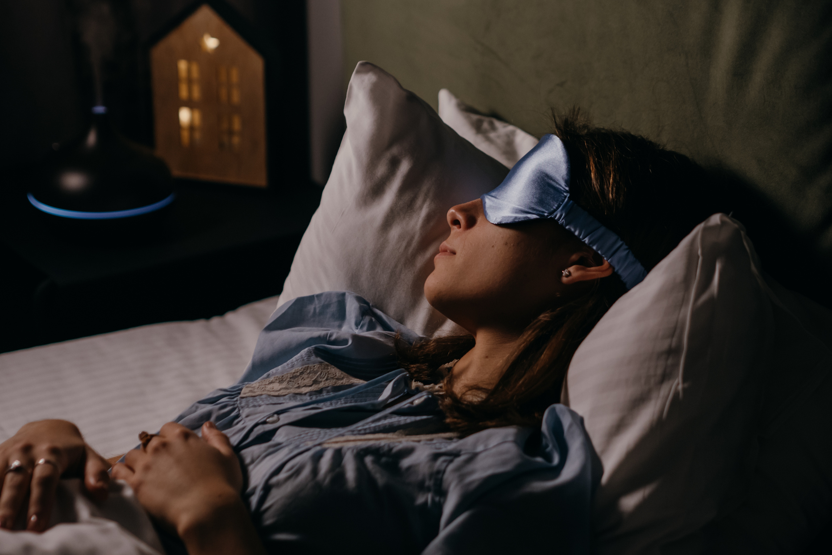
Sleep and Health
Sufficient sleep is essential for maintaining optimal physical health, mental and emotional functioning, and cognitive performance.
Inadequate and poor-quality sleep interfere with quality of life, increase stress levels and can be hazardous to health.
Notes:
The average person has worse health outcomes (including more obesity, diabetes, and heart disease, and shorter life) if he or she sleeps less or more than these ranges, on average.
In recent years, we've learned that during sleep, waste material is flushed out of our brains. For example, the waste material includes proteins involved in Alzheimer's disease. A recent study in mice found that interrupting sleep repeatedly led to worsening atherosclerosis. It's much less clear why people who sleep more than recommended also have worse health outcomes.
Many report that their stress increases when the length and quality of their sleep decreases.

Slide 12
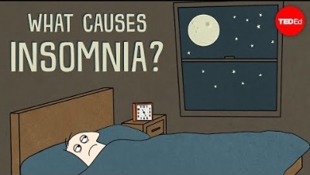
Notes:
https://www.youtube.com/watch?v=j5Sl8LyI7k8

Slide 13

Sleep Through the Ages
Adolescents (ages 12-18)
Need 9 hours of sleep for optimal health.
Often experience delayed sleep phase syndrome
Adults (ages 18 to 64)
7-9 hours of nightly sleep
More likely to experience sleep disorders
Older adults (65+)
7-8 hours recommended
Notes:
Millennials and Gen Xers report getting fewer hours of sleep per night on average, and are more likely than other adults to say they do not get good-quality sleep and have more trouble achieving their sleep goals. Younger adults are more likely to say they feel stressed by a lack of sleep.
Adults report sleeping an average of 6.7 hours a night — less than the minimum recommendation of seven to nine hours. 43 percent report that stress has caused them to lie awake at night in the past month.
Many report that their stress increases when the length and quality of their sleep decreases.

Slide 14

Sleep and Stress
Chronic feelings of stress can cause the nervous system to maintain a heightened state of arousal
Cause sleep deprivation by delaying the onset of sleep and cause rapid, anxious thoughts to occur at night
A lack of sleep can cause the body to react as if it's in distress, releasing more of the stress hormone, cortisol.
Notes:
Sleep’s ability to regulate the immune system, and even improve it, is an essential aspect of a stress-free life. We all know sickness isn’t fun, but it also adds a lot of burden to an already busy body. Along with mental stress, illness in one part of the body puts a lot of physical stress on the rest of your systems, causing them to overwork and strain themselves to exertion.
While you sleep, however, your body takes stock of itself and produces substances that fight infection and defend against illness. Therefore, getting the sleep you need to maintain your immune system can improve your response to illness, shorten the time it takes to recover, and allow you to get back to normal life.

Slide 15
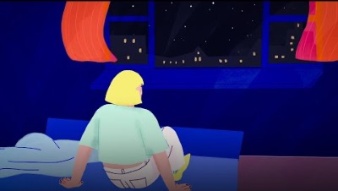
Notes:
https://www.youtube.com/watch?v=t0kACis_dJE
Guidelines for Better Sleep
Maintain a regular sleep / wake schedule whenever possible- even on weekends and vacations​
Avoid napping during the day, especially after 3pm. Limit naps to < 1 hour.​
Establish a regular, relaxing bed time routine​
Exercise regularly – but not within 2 hours of sleep​
Avoid eating large meals just before going to sleep​
Avoid caffeinated beverages, particularly after lunch​
Avoid the use of alcohol and nicotine as these substances can disrupt sleep

Slide 16

Noise and Stress
Noise can increase blood pressure, heart rate, and muscle tension
Results in irritation, anxiety, headaches, increased blood pressure, and sleep problems
At 85 decibels, stress responses develop
Prolonged exposure to sounds above 90 dbs result in hearing damage

Slide 17
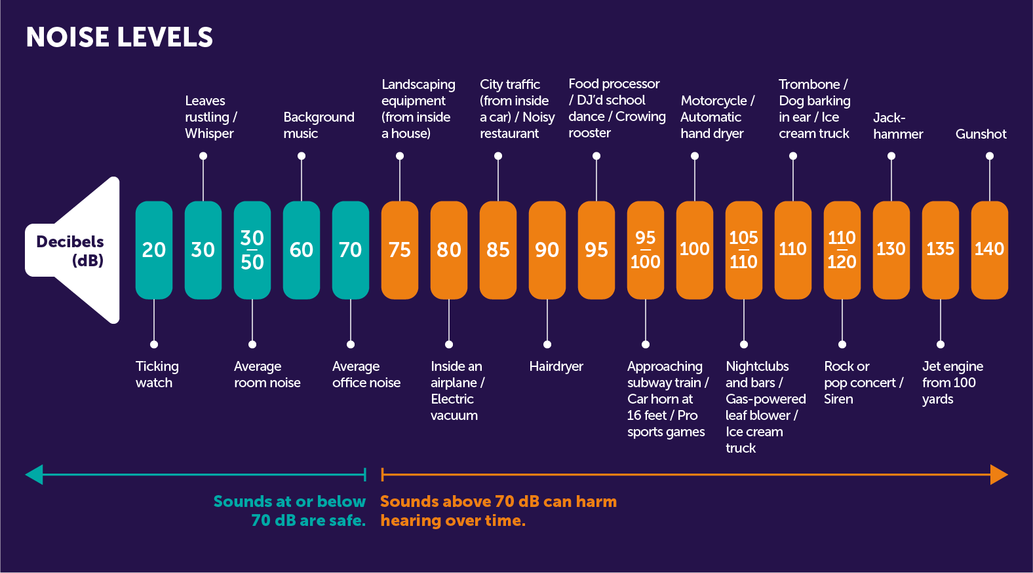
Notes:
At 85 decibels, stress responses develop.

Slide 18
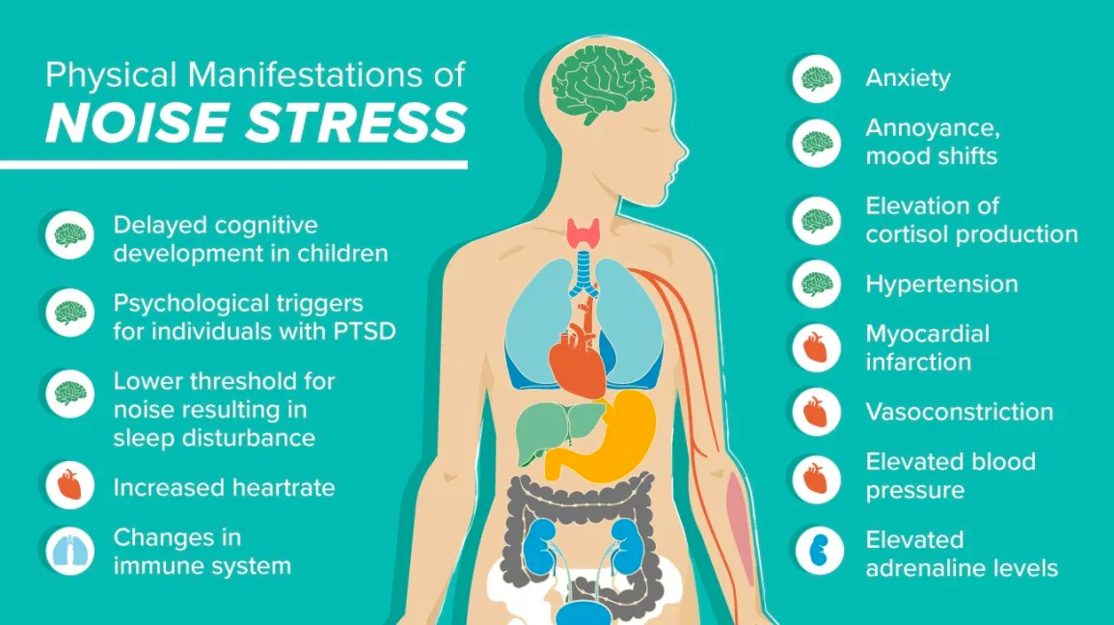

Slide 19

Reduce Excessive Noise
Do a simple noise assessment of your environment
Avoid places with high noise level
Wear ear plugs
Plan for quiet time
Turn down the volume
Walk away from the noise
Notes:
1) Stop for a moment. Listen. Is there background noise that could be eliminated or ameliorated? (Did you leave the TV on?)
2) Avoid places with a high noise level or limit your exposure.
When you find yourself raising your voice over noise, that's a clue that noise pollution could be harming your hearing.
3) Plan to bring noise-cancelling plugs/muffs when noise is unavoidable, such as on airplane flights.
4) Give yourself a break from even “good noise” (sorry about the oxymoron) such as your beloved music. Turn off the TV.
5) Turn down the volume on TVs, portable music players, and other sound systems. How low can you go and still hear comfortably? Experiment.
6) Walk away from noise: If the outside environment is noisy, go inside and/or close windows. If the inside environment is noisy, go out.

Slide 20

Technology and Stress
Technology can be very helpful, even healthy. We can use technology to:
Keep up-to-date with people we care about
Find new people who share our interests, such as joining an online group or club
Play games that build skills or teach us something in a fun way
Watch videos that inspire us, move us, or make us laugh
Organize our time or tasks, such as using calendars or checklists to schedule priorities
Monitor physical activity and health goals

Slide 21

Technology and Stress
Technology can be a problem when it no longer helps and begins to cause harm such as feeling overwhelmed or anxious
Technology may be harming you if you:
Feel pressure to look a certain way on social media or other sites
Feel disappointed if you don't immediately get a reply to a message or post
Can't ever see myself without my favourite technology for too long
Technology use is impacting my health, like sleep, eating habits, or my exercise routine
Notes:
Further thoughts to see if you might have a problem with technology use:
I spend a great deal of time thinking about going online, using or checking my phone, or other device
The amount of time I spend on technology, such as texting or spending time online, negatively affects other parts of my life, such as relationships, my performance at work or school, or necessary daily tasks
Using technology helps me ignore problems or difficult feelings, or avoid doing things I have to do
I feel nervous, anxious, or irritable when I don't have access to my phone or other devices
I sometimes feel like I can't control my technology use
I've tried to cut back on the technology use that's causing problems, but I just go back to old patterns
Technostress: First appeared in Craig Brod's book (Brod, 1984) titled Technostress: The Human Cost of the Computer Revolution. The term refers to one's inability to cope with technology that results in distress.
Information overload and constant contact with digital technology devices and applications are responsible for an abnormal response to stress, with specific physical, emotional and mental symptoms.

Slide 22
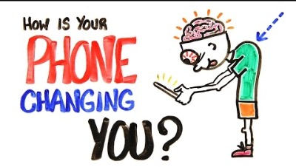
Notes:
https://www.youtube.com/watch?v=W6CBb3yX9Zs

Slide 23

Finding a Balance with Technology
Turn off unnecessary notifications.
Use apps and programs that limit your access to certain website, apps, or other features.
Try to reduce screen time before bed and keep screens out of the bedroom.
Regularly choose off-screen activities over on-screen activities.
Reduce distractions- focus on one activity
Avoid comparing yourself to people you see online, including your friends
Notes:
Set a schedule—and stick to it. Give yourself a set period of time each day to check social media or personal email, for example.
Turn off unnecessary notifications. Unless it's part of your work or another important obligation, many notifications on your phone and other devices may not be needed.
If you have a hard time limiting technology use, take advantage of apps and programs that limit your access to certain website, apps, or other features.
Set guidelines and discuss your expectations with others. For example, you and your friends might agree to put your phones away when you're out for dinner. If a family member often texts late at night, you might let them know that you plan stop checking messages at a certain time.
Try to reduce screen time before bed and keep screens out of the bedroom. It’s easy to stay up much later than intended when you're online, gaming, or trying to write a few emails before bed. There is also evidence that the blue light emitted by devices may affect healthy sleep, long after you've turned the device off.
Regularly choose off-screen activities over on-screen activities. For example, choose to play soccer with friends over playing a video game of soccer.
Reduce distractions. Many of us split our attention between a few different activities, like playing games while watching a movie or watching TV while eating dinner. Try to designate one distraction-free day or evening a week so you can focus on the most important activity.
Avoid comparing yourself to people you see online, including your friends. Remember that people usually just post their good news and their best pictures online—and a lot of people edit their photos and use filters to make them look as good as possible.

Slide 24



LIFE EVENTS AND STRESS
A life event is a significant experience which can lead to an increase in stress.
May require extra energy for adjustments to be made
Ex. Vacation or divorce
Notes:
Disruptive change in a person’s life caused by the event will crease stress. Therefore, both positive and negative life events which necessitate change in a person’s life can lead to stress.
Depends on the person. For example, people generally think that divorce is a stressful experience; however, for some individuals, such as those who have gone through a long-term problematic marriage, divorce can be a resolution of stress and even a relief.

Slide 25
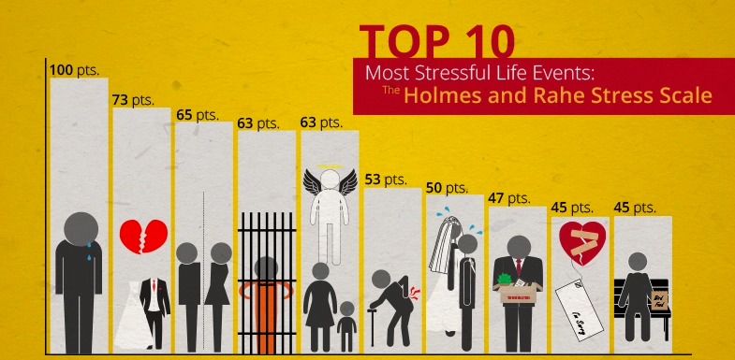
Notes:
Thomas Holmes and Richard Rahe decided to study whether or not stress contributes to illness. They surveyed more than 5,000 medical patients and asked them to say whether they had experience any of a series of 43 life events in the previous two years.
Each event, called a Life Change Unit (LCU), had a different "weight" for stress. The more events the patient added up, the higher the score. The higher the score, and the larger the weight of each event, the more likely the patient was to become ill.

Slide 26

DELONGIS’ HASSLES AND UPLIFTS SCALE
Examines daily hassles and uplifts with life events as measures of stress
Daily hassle: relatively minor events that happen during the course of the normal day
Daily uplifts: positive everyday experiences that are thought to counteract the effects of daily hassles
Found that the hassles, correlated negatively with their reported health
Notes:
Psychologists also recognised the effect of more positive minor events, or uplifts, on a person’s stress levels. They believed that such events could help to counteract the detrimental effect of hassles on an individual’s stress level.

Slide 27

Counteract Against Daily Stress
Build social connections
Become mindful
Retake control
Stay physically active
Avoid alcohol and comfort foods
Notes:
Strong social networks — especially if they include some close confidants — help us regain our emotional balance and rein in our anxiety.
Mindfulness - allows us to focus on what is happening in the present moment, rather than indulging in past anger or remorse, or fear of the future. Practicing mindfulness on a regular basis improves the brain functions that enhance our ability to avoid excessive stress responses.
A perceived lack of control is among the most debilitating factors in terms of stress biology — in the extreme, learned helplessness leaves us shattered. We can look for opportunities to expand our sense of control, both at work and in daily life, through asserting ourselves
Stay physically active- Physical activity directly reduces excess cortisol — also known as the “fight or flight” hormone
Certain choices we make may reduce stress temporarily, but then have long-term negative effects on health and well-being. “Comfort foods” with high calories and fat do counteract cortisol, but at the risk of increasing the chances of heart diseases and other disorders. In the same way, substances like alcohol and other drugs can briefly alleviate the feelings of being over-stressed and agitated, but at a risk of becoming a “go-to” solution that can cause serious problems down the road.

Slide 28
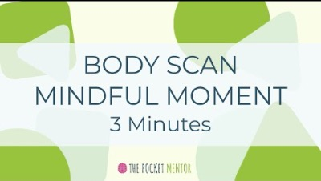
Mindful Moment

